Slide 1
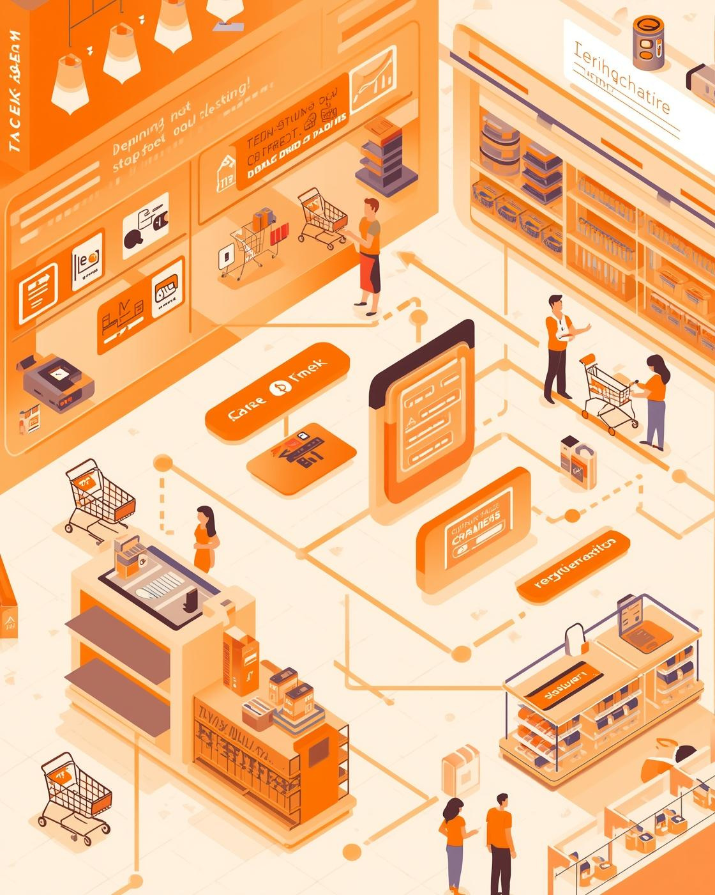

SUPERMARKET
Management System
DESIGNED BY SUBIKSHA R

Slide 2

Abstract
The Supermarket Management System is a full-stack web-based application designed to streamline billing, order history, and stock management in supermarkets.
Customers can make purchases and generate bills digitally, while admins can monitor inventory, update prices, and view reports.
The system uses ReactJS for the frontend, Spring Boot for backend processing, and MongoDB for data storage.
It ensures fast, error-free transactions, real-time updates, and reduces manual work for supermarket staff.

Slide 3

Existing System
Billing and stock management are mostly manual, leading to human errors.
Paper-based records make data tracking difficult.
No real-time visibility into inventory or sales performance.
Generating reports and bills is time-consuming.
Customer data is not securely stored or easily retrievable.

Slide 4
Proposed System
Introduces a digital and automated platform for all supermarket activities.
Provides real-time billing, order tracking, and inventory management.
Allows admin to update stock, manage products, and view reports easily.
Reduces manual effort and improves overall accuracy.
Offers a clean, responsive interface accessible from any device.

Slide 5
Disadvantages:
Requires continuous internet connectivity.
Server downtime may interrupt billing.
Setup requires initial technical configuration.

Slide 6
Advantages:
Fast, accurate, and paperless billing.
Real-time updates for stock and orders.
Easy report generation and data retrieval.
Reduces staff workload and operational errors.

Slide 7
Hardware Requirements
Processor: Intel i3 or higher
RAM: 4 GB or more
Hard Disk: Minimum 500 GB
Display: 1024 × 768 resolution or higher
Operating System: Windows 10 or later

Slide 8
Software Requirements:
Frontend: ReactJS
Backend: Spring Boot
Database: MongoDB
Tools: VS Code
Browser: Google Chrome / Microsoft Edge
Server: Spring Boot Embedded Tomcat Server

Slide 9
Modules
Login Module: Manages authentication for admin and staff.
Billing Module: Calculates total amount and generates bills.
Order History Module: Displays previous orders and transactions.
Inventory Module: Handles product details, pricing, and stock updates.
Reports Module: Generates daily and monthly sales summaries.

Slide 10
Module Description
Login Module: Securely verifies users before access.
Billing Module: Calculates totals and updates product stock after each sale.
Order History Module: Maintains previous transactions for quick reference.
Inventory Module: Tracks product quantities and alerts for low stock.
Reports Module: Provides insights into total sales and performance trends.

Slide 11

System Architecture
Flow:
User → React Frontend → Spring Boot Backend → MongoDB Database
React JS: Handles user interaction and dynamic UI updates.
Spring Boot: Processes billing logic, stock control, and order data.
MongoDB: Stores all customer, order, and product information.
REST API: Facilitates secure data exchange between frontend and backend.

Slide 12
Tools & Technologies Used
Frontend: React JS, HTML, CSS, JavaScript, Axios
Backend: Spring Boot Framework
Database: MongoDB (NoSQL)
Testing Tools: Postman (API testing)
Development Environments: VS Code, Eclipse IDE

Slide 13
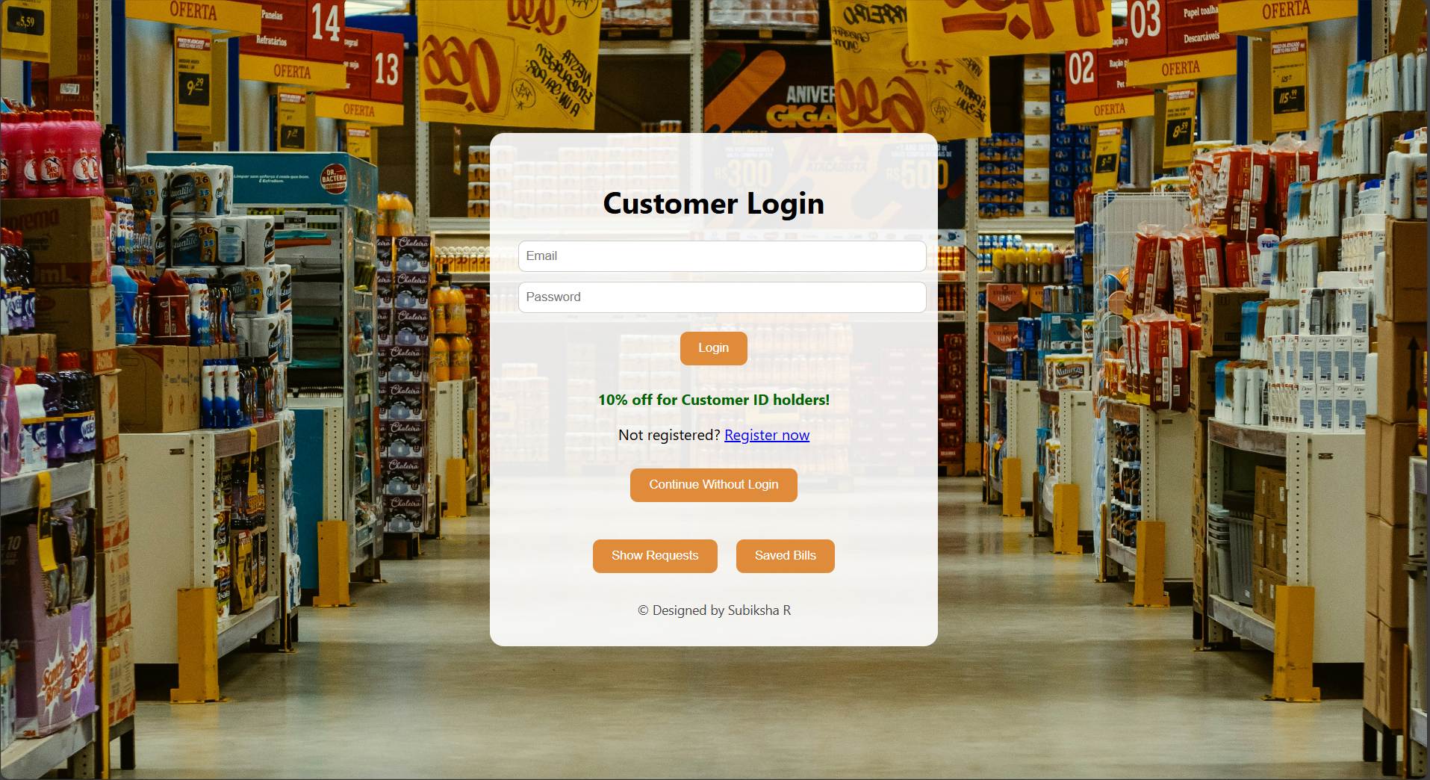
Home Page Interface

Slide 14
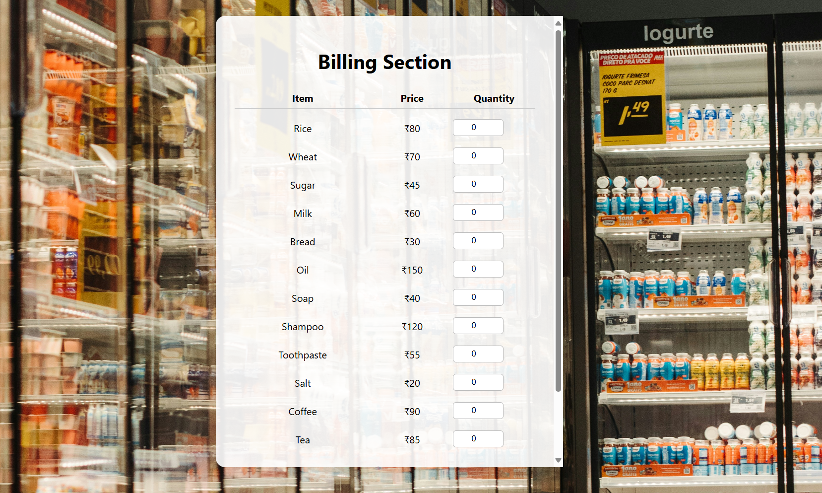
Billing Page Interface

Slide 15
Conclusion:
The system successfully automates key supermarket operations like billing, stock, and order tracking.
It ensures real-time data updates and minimizes human errors.
The application is user-friendly, efficient, and improves overall management workflow.
Built using ReactJS, Spring Boot, and MongoDB, it provides a secure and scalable digital solution.

Slide 16
Thank You

